Slide 1
ITSA線上程式競賽基礎題目
#11~15

Slide 2
題目11. 矩陣反轉 (transpose)
https://e-tutor.itsa.org.tw/e-Tutor/mod/programming/view.php?id=30760
運算思維: (課堂講解)
程式碼說明: (課堂講解)

Slide 3
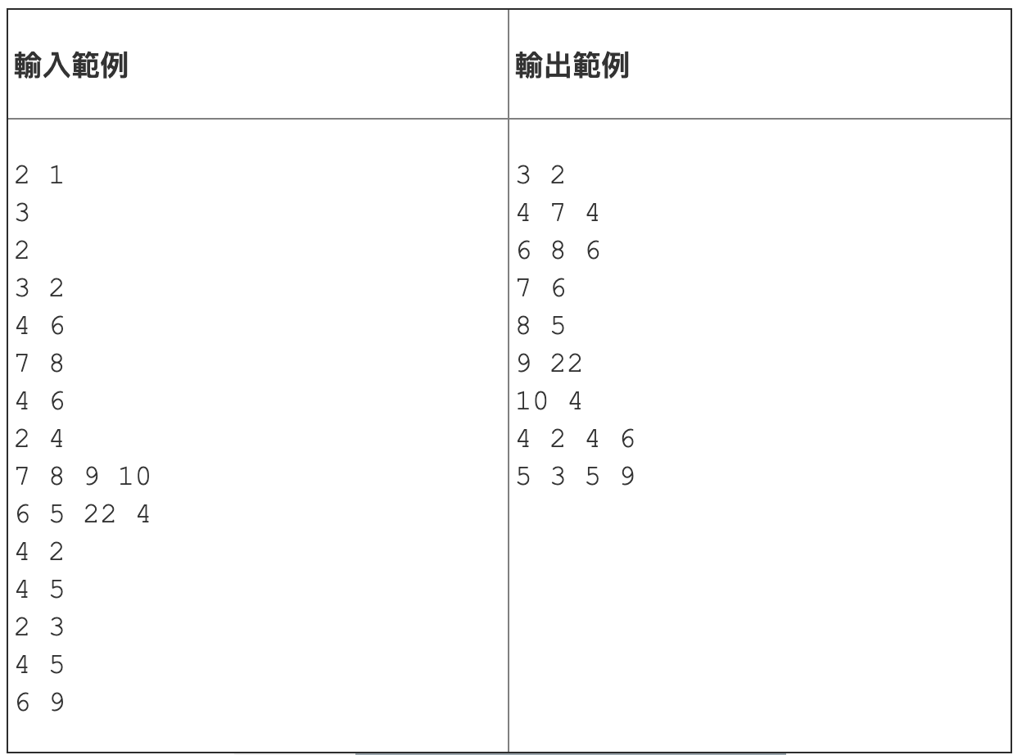
4 | 7 | 4
6 | 8 | 6
4 | 6
7 | 8
4 | 6
A00 | A10 | A20
A01 | A11 | A21
A02 | A12 | A22
A00 | A01 | A02
A10 | A11 | A12
A20 | A21 | A22

Slide 4
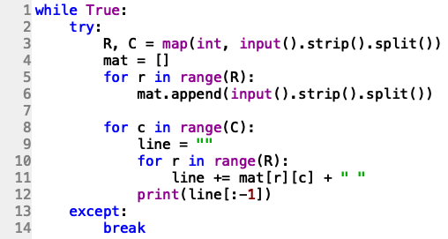
A00 | A01 | A02
A10 | A11 | A12
A20 | A21 | A22
A00 | A10 | A20
A01 | A11 | A21
A02 | A12 | A22

Slide 5
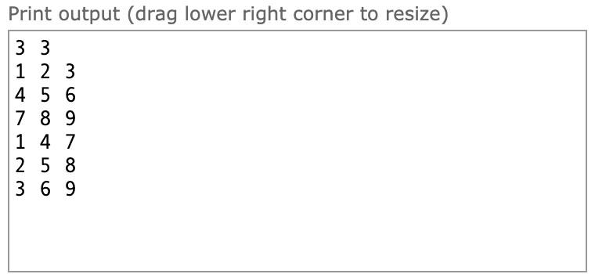
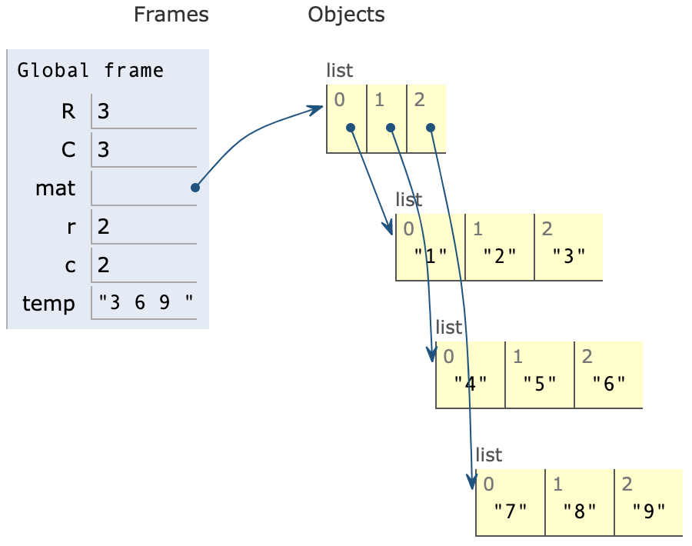
善用Python tutor
http://pythontutor.com/live.html#mode=edit

Slide 6
題目12. 遞迴程式練習
https://e-tutor.itsa.org.tw/e-Tutor/mod/programming/view.php?id=30761
運算思維: (課堂講解)
程式碼說明: (課堂講解)

Slide 7
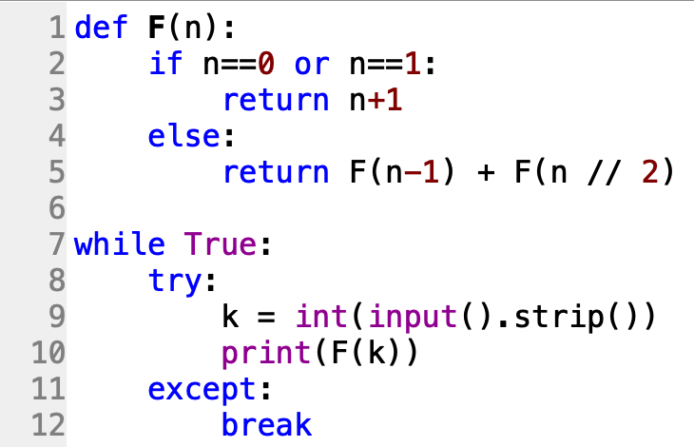

Slide 8
題目13. 撲克牌大小
https://e-tutor.itsa.org.tw/e-Tutor/mod/programming/view.php?id=30764
運算思維: (課堂講解)
程式碼說明: (課堂講解)

Slide 9
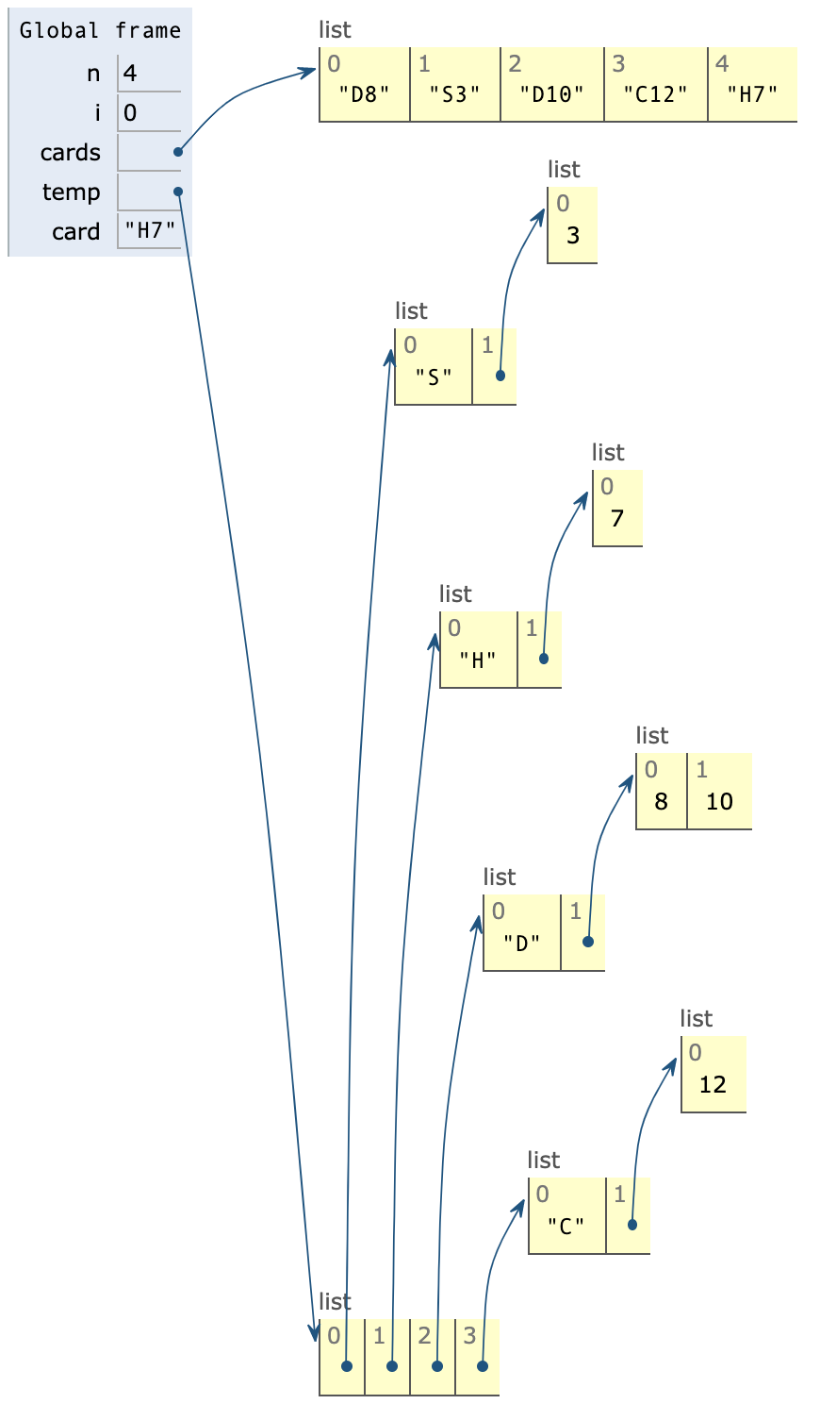
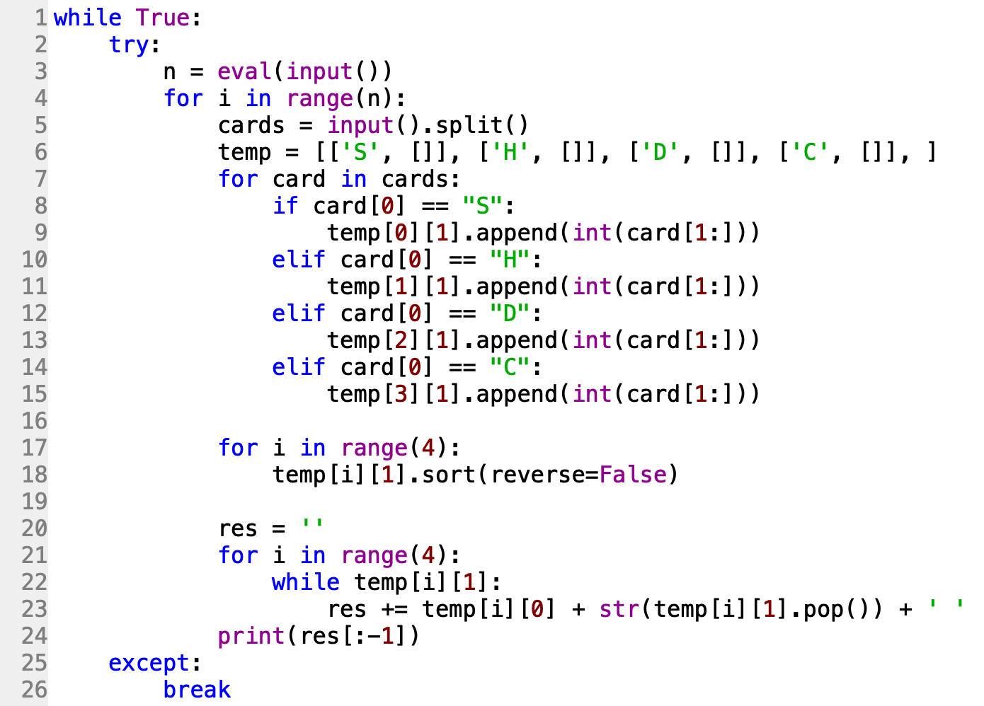

Slide 10
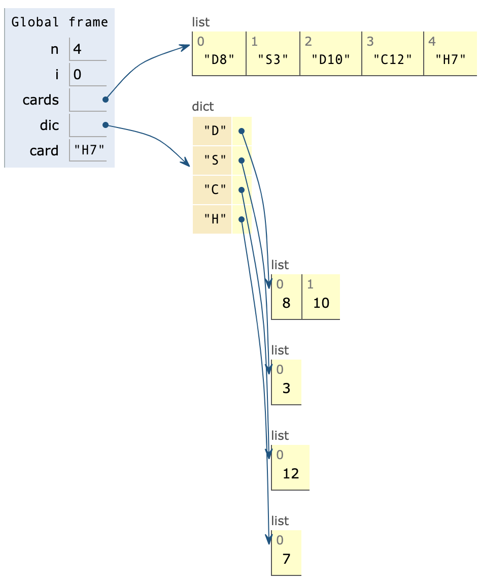
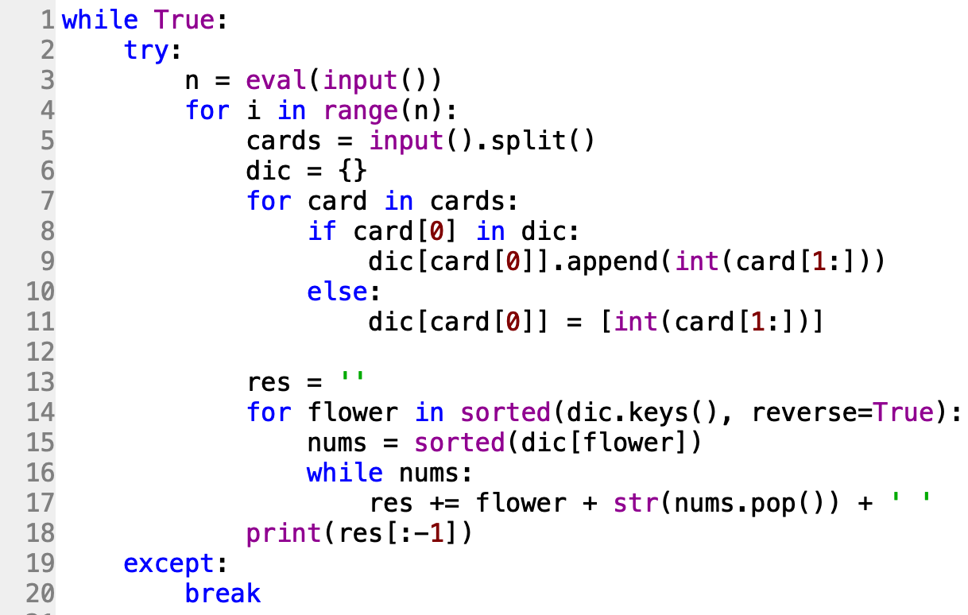

Slide 11
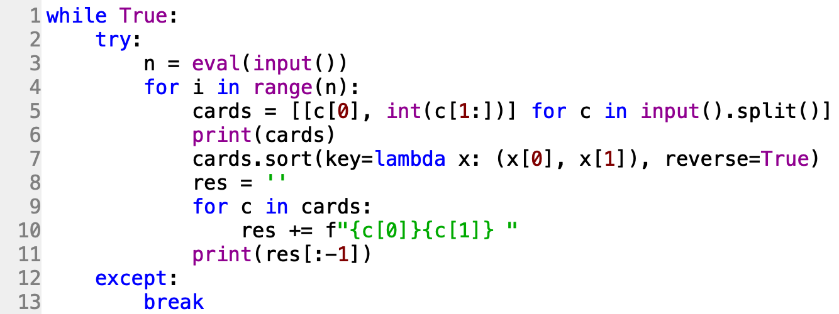
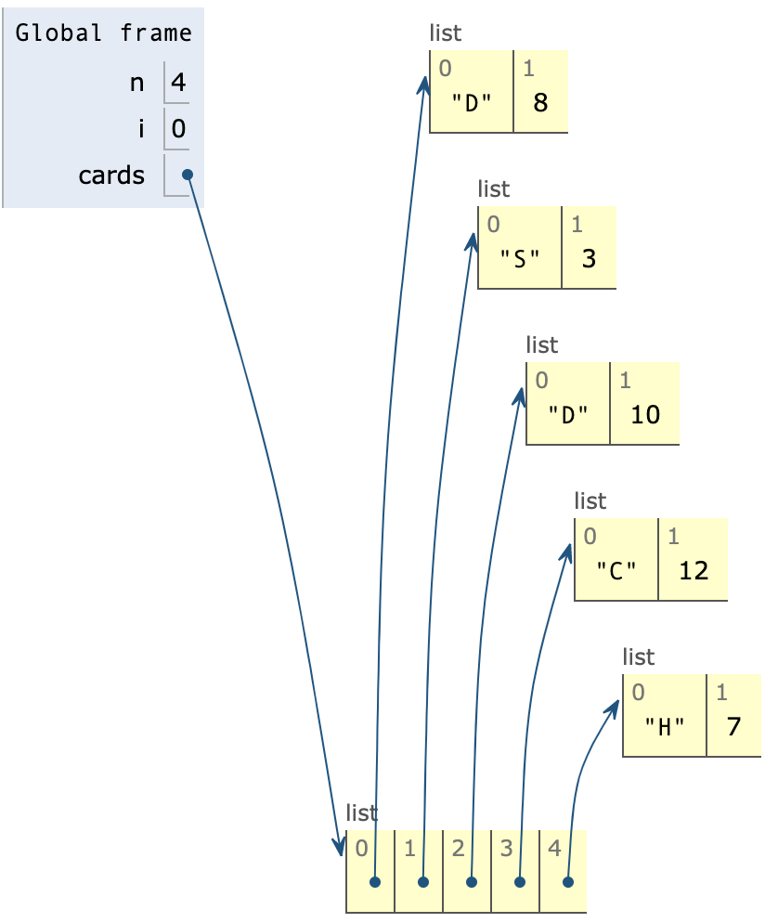
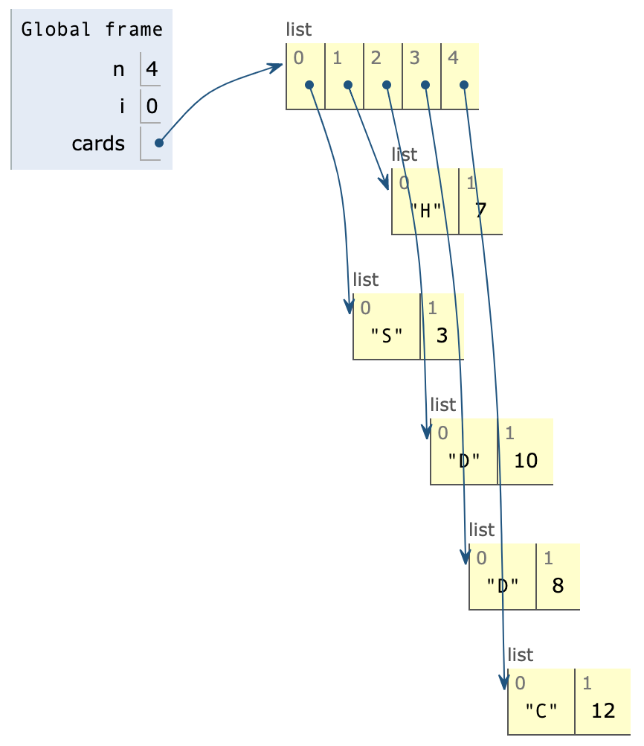

Slide 12
題目14. 判斷是否為迴文
https://e-tutor.itsa.org.tw/e-Tutor/mod/programming/view.php?id=30766
運算思維: (課堂講解)
程式碼說明: (課堂講解)

Slide 13
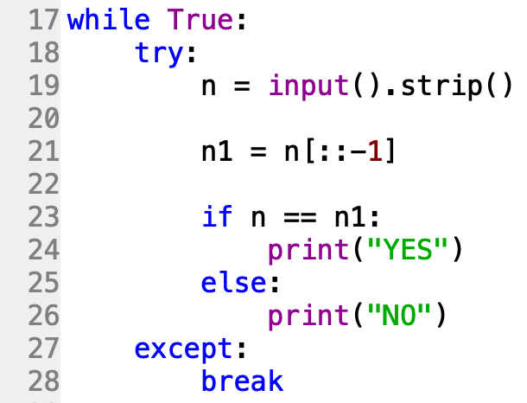
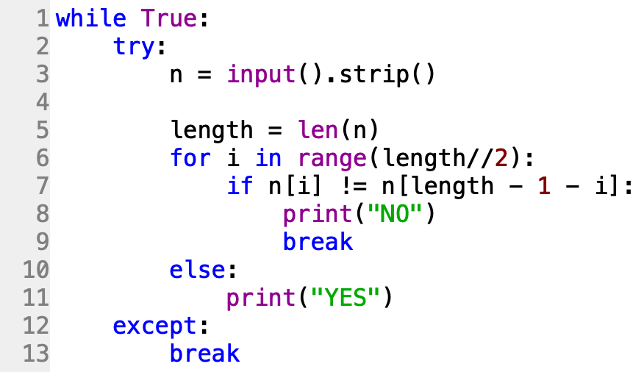
1 | 5 | 5 | 6 | 5 | 5 | 1

Slide 14
題目15. 文字及字母出現次數
https://e-tutor.itsa.org.tw/e-Tutor/mod/programming/view.php?id=30757
運算思維: (課堂講解)
程式碼說明: (課堂講解)

Slide 15
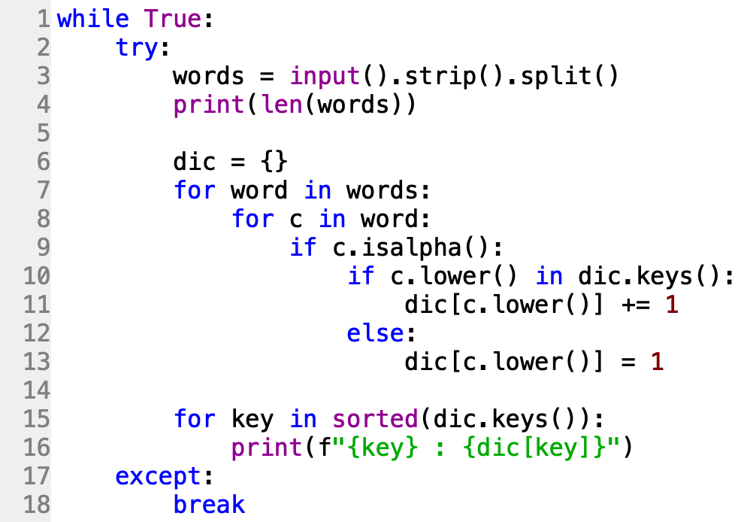

Slide 16
